Slide 1
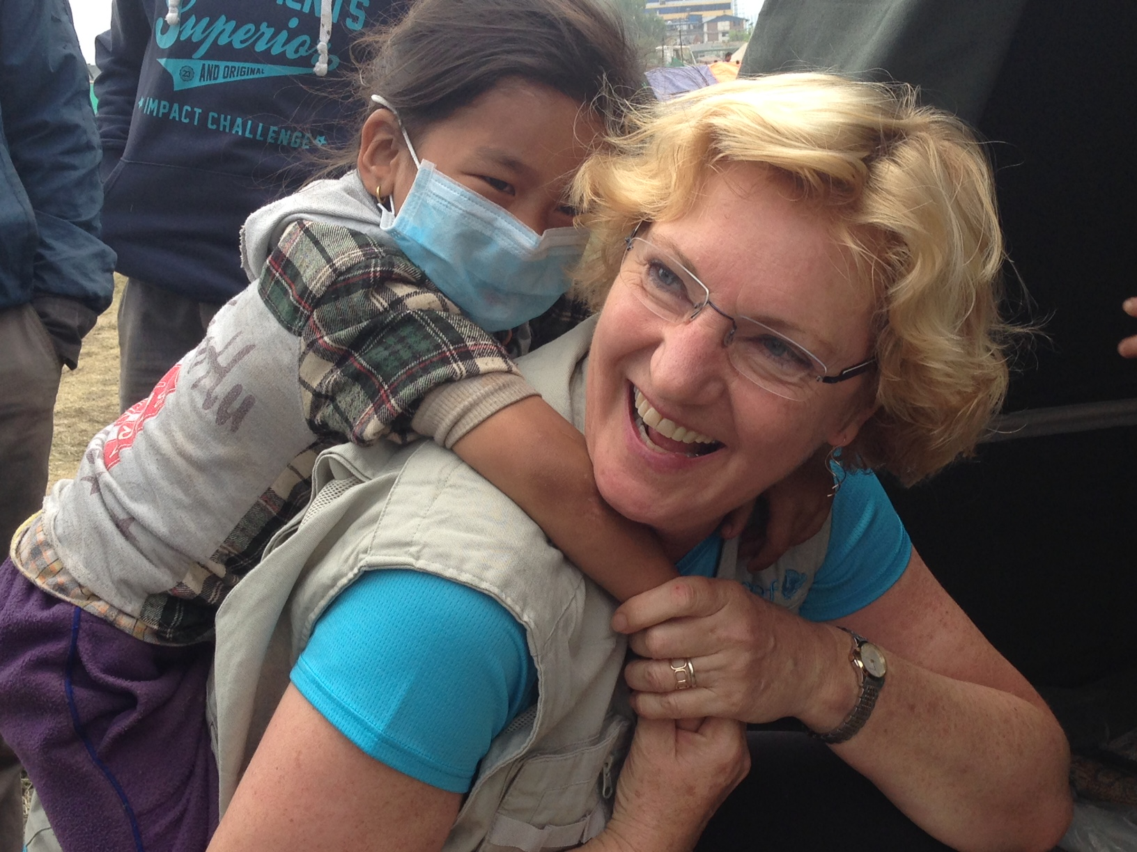
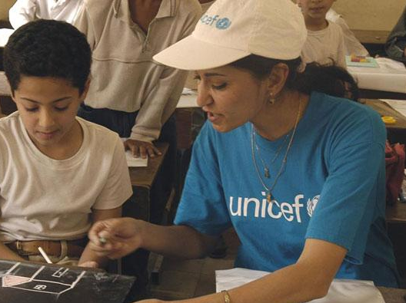
Welcome to
Allen HS UNICEF Club
Est. 1946

Slide 2
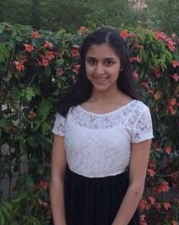
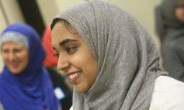
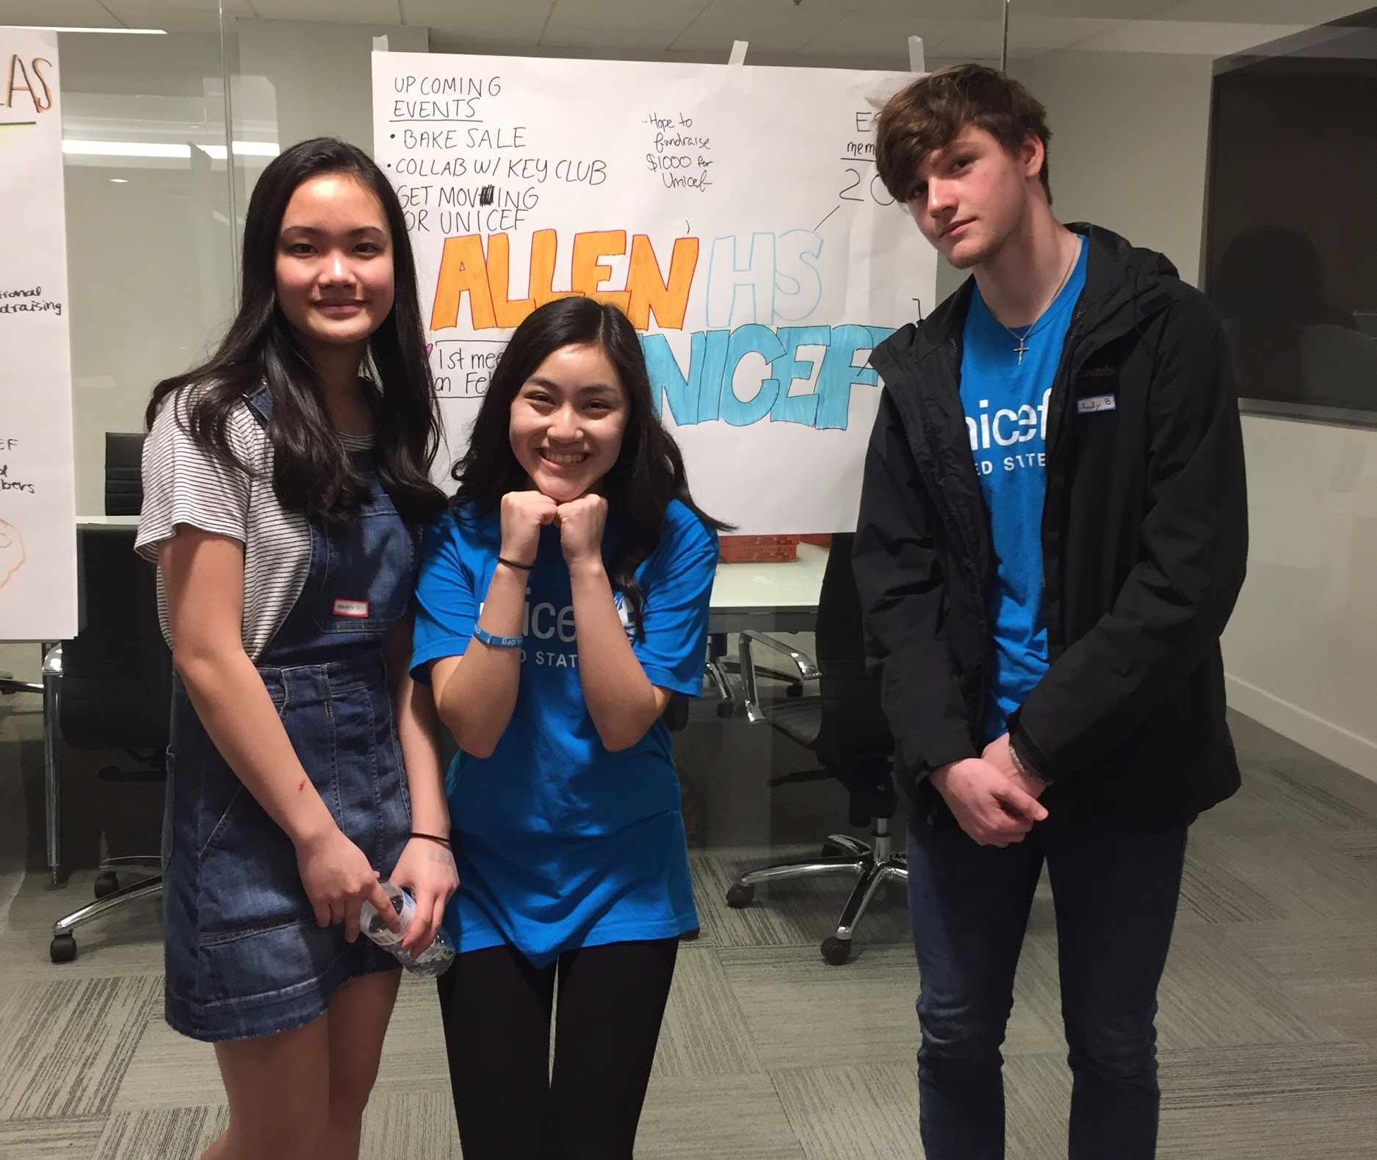
Meet the Board
Co-Presidents- Katie Nguyen and Katherine Huang
VP- Andy Barlow
Treasurer- Alizay Azeem
Historian- Sruthi Potturi
Secretary- Ryan Liao
Sponsor: Mrs.Lee

Slide 3
Stay in the Loop!
Twitter: @UNICEFahs
Remind 101: Enter 81010 and text @unicefal
Email: unicefallen@gmail.com
Website: http://allenhsunicef.weebly.com/

Slide 4
Membership
Register as an official volunteer for UNICEF
http://bit.ly/2lKb58l
Required for every member

Slide 5
Upcoming Events
Here are some activities we have planned out this semester:
Bake Sale April 3-7
Reading Partners Book Drive On-Going!!!
Refugee Play Day on March 25th
Guest Speaker March 28th
More volunteer events to come

Slide 6
March 25th: REFUGEE/COMMUNITY PLAY DAY (5 point event)
Talk to Alizay Azeem (treasurer) to sign up or email her at alizayazeem@gmail.com/ alizay.azeem@student.allenisd.org
New Donations Needed!
deodorant, shampoo, soap, lotion, shaving cream, razors (pack of 10), diapers
You can earn 3 points for every item donated! Max of: 6 points
Drop all items off in Mrs. Lee’s room by Friday March 17th! (please keep keep items in a bag with your name on it or we will not be able to distribute your points)

Slide 7
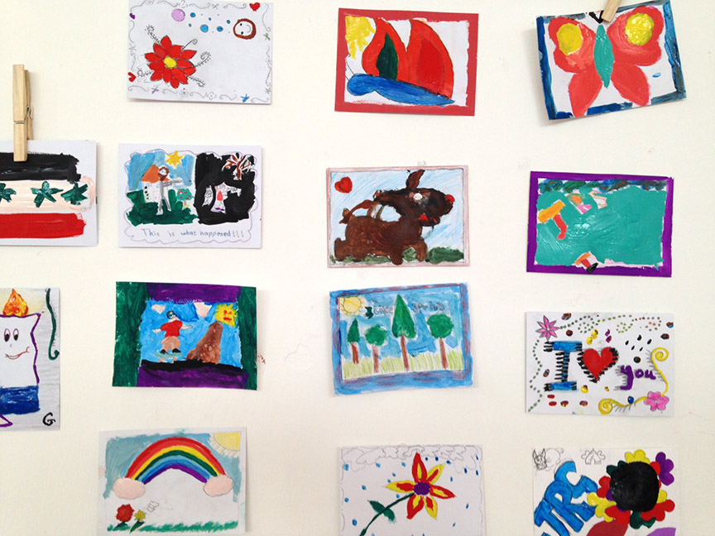
TODAY’S AGENDA
Postcards to Refugees
Today we will be writing postcards of hope to refugee children

Slide 8
anyrefugee.org

Slide 9
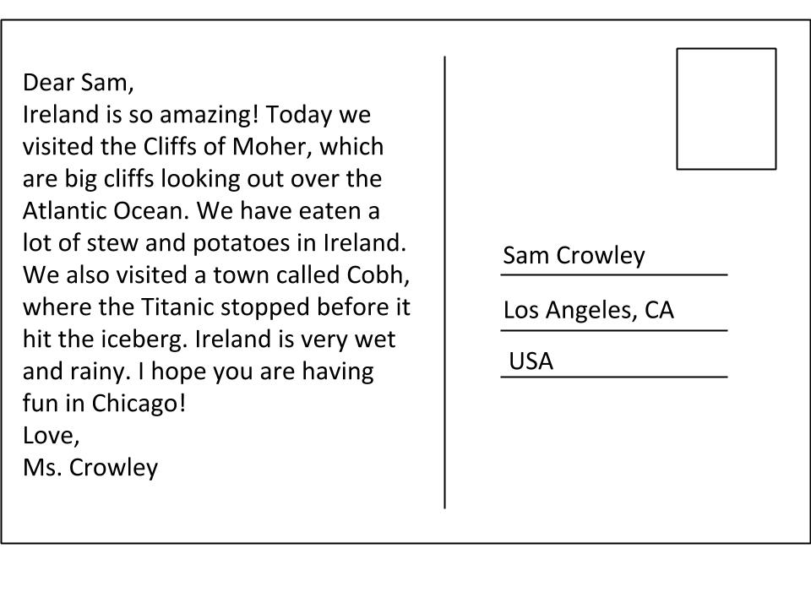
Write an uplifting message or a tibbit from your life on the left side with the UNICEF logo. (School appropriate!!!)
Sign it from, sincerely, best wishes, etc. with your name and UNICEF Allen High School
Decorate the blank side with a comic or fun design
CAREFULLY cut a couple stickers and tape it onto the side that has the address on it.
Hi,
After the long journey here, I hope you feel safe and welcome! Your resilience inspires me everyday.
With love,
Jane Smith
UNICEF Allen High School
Address Here

